Slide 1
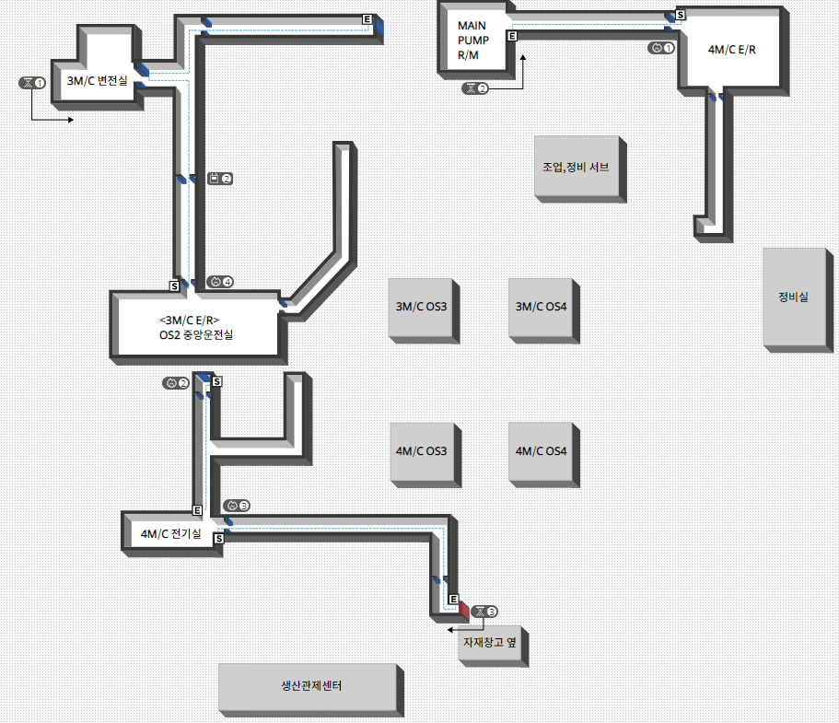

#2
#3
#15
(G)
#14
(F)
#13
(C)
#4
#6
#5
#12
(B)
#11
(A)
#17
(J)
#10
#16
(I)
#9
#8
#7
#18
(K)

Slide 2
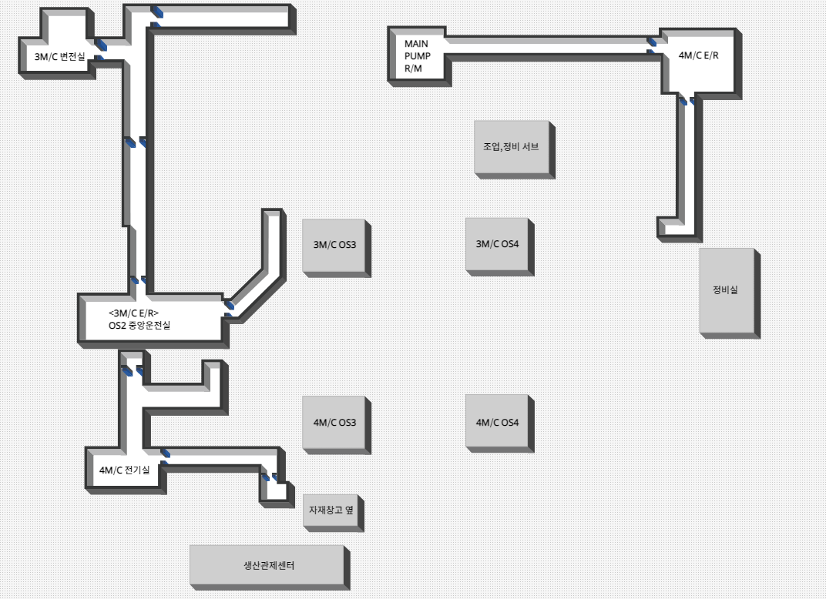
#1
#3
#13
(C)
#13
(C)
#2
#4
#5
#6
#12
(B)
#11
(A)
#10
#9
#8
#7

Slide 3
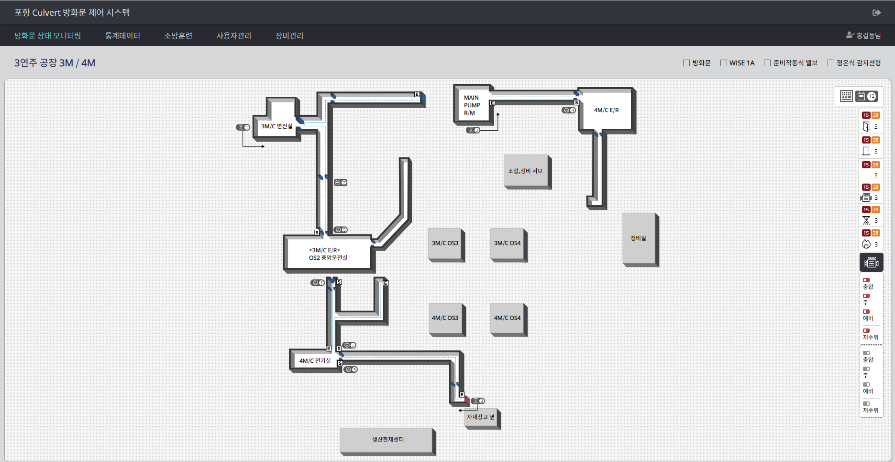
#1
#1
#2
삭제
#4
#2
삭제
#1

Slide 4
#1
#6
#5
#2
#12
#8
#3
#9
#13
#10
#4
#11
#7

