Slide 1
Virtual Terminal 2.0
System Architecture
㈜클릭앤터치
2018.11.01

Slide 2
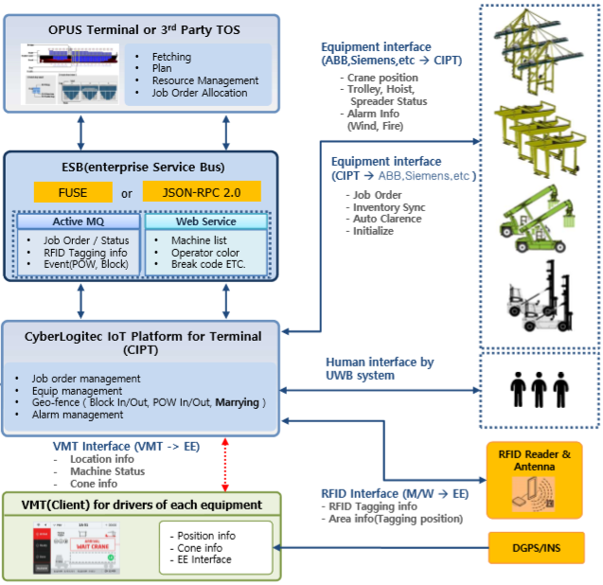
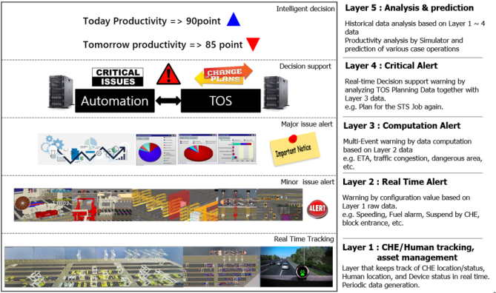
1. System Architecture
1. Hardware Architecture
Virtual Terminal 2.0 App.
Unity App. Windows App.
Object Editor
Map Editor
Screen Template Editor
Rule Manager
Configuration Manager
Install & Live update manager
Legacy Interface Module
Rewinder
Virtual Terminal M/W Interface Module
Virtual Terminal Interface Module(CIPT)
Virtual Terminal App. Interface Module
Virtual Terminal App. 관련 Data Management

Slide 3
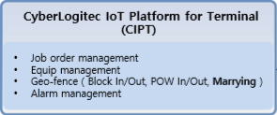

1. System Architecture
2. Process Architecture
CyberLogitec to IoT Platform for Terminal
Simulator (CIPTS)
Multi Screen
Summary View
Screen Control
Screen View
2D
Unified Search
Object Event
3D
OTRList Viewer
Database
Virtual Terminal Interface
Tool Bar
Camera Setting
Magnifier
응답
Push
Historical Information
TCP/IP통신
요청
파이프 통신
Inner Interface Module
주기적Data
비주기적Data
Virtual Terminal 2.0
Virtual Teminal
Rule Manager
Virtual Terminal Interface Module
Screen View
Data View
Data View
Monitoring
Object Editor
View
Help
Setting

Slide 4
3. Screen View / Data View
Virtual Terminal 2.0
Virtual Terminal 2.0
Screen View
Data View
WPF
profile
Virtual Terminal
- Connection List
- Log Out
- Exit
MultiViewport
NetFacade
System
Summary
Carmera3D
DriverView
Sync Item
Monitoring
- Rewinder
- Server Resource Monitoring
System Monitoring
파이프 통신
Alert
View
- 2D
- 3D
- Terminal TreeView
- Summary
- Summary View
- Event Message View
- Screen Capture
- Snapshot
Machine
Embeded Unity 3D
Job
Model
Information
Configuration
Object Editing
Crane
Resource
Setting
- ServerIP Setting
- Camera Setting
- View Filter
- Setup Configuration
- Shortcut Key Setting
Terminal
Object
UserProfile
Object add
Gate
GeoFence
Object Export
plan
Vessel
Warning
Multi Viewport
vessel
Rule Manager
- User Account
Management
- User Authority Setting
- Geo-fence
- threshold Setting
Rewinder
replay
Car
viewFilter
Rule
Manager
Container
Machine
Senser
timer
Object
Object
Manager
Object Editor
Crane
Color
Camera
Information
Help
- Manual
- Info. VT
Message

Slide 5
1. System Architecture
4. TCP/IP 통신프로토콜
TCP/IP 통신 규격(VT to Server)
구성 | size | 항목 | 설명
Header | 4Byte | Marking | 마킹 (0xa5 0xa5 0xa5 0xa5)
 | 4Byte | Data Size | 전체 데이터 사이즈 (실 데이터 + 16바이트(헤더))
 | 4Byte | Acknowledgement | Ingeger, Ack : 1 (0x31) , Nack : 0 (0x30) Ping or Pong 우선 송신 시 : 2 (0x32)
 | 4Byte | Protocol ID | 프로토콜 고유 ID
Data | nByte | NetData | 실 데이터
0
16
Header
Data
0
4
8
12
16
N
4 byte
4 byte
4 byte
4 byte
N byte
Marking
Data Size
(Header 포함)
Sequence
Protocol ID
Data

Slide 6
1. System Architecture
5. 3D View (unity3D)

Slide 7
1. System Architecture
6. Multi Screen (unity3D)

Slide 8
1. System Architecture
7. Object 처리 (unity3D)

Slide 9
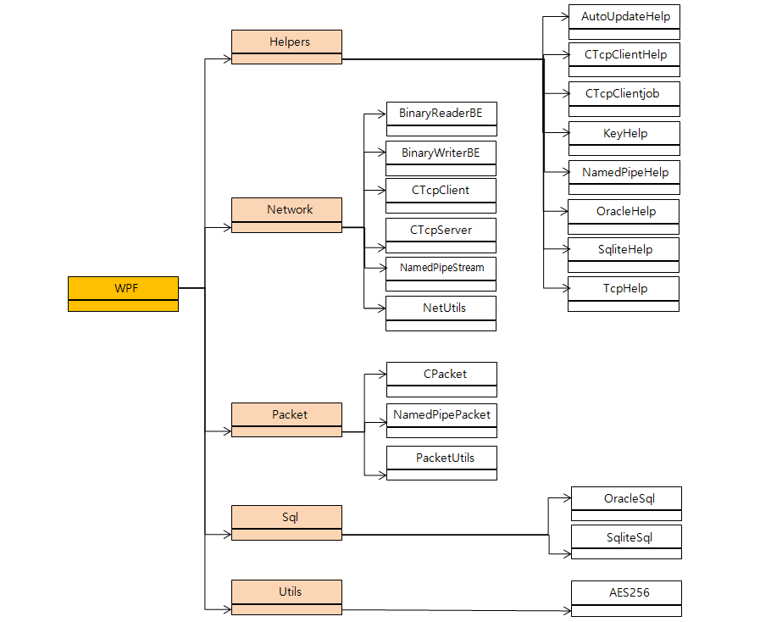
1. System Architecture
8. WPF

Slide 10

Thank you very much for your attention!
dugong@clickntouch.co.kr

