Slide 1
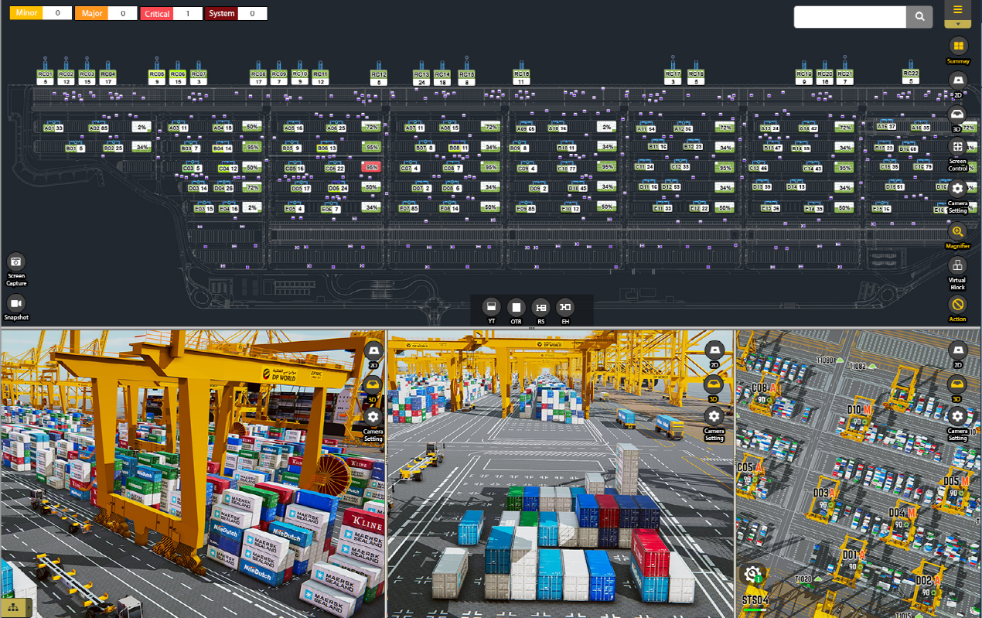

VT Monitoring Screen View > 통합검색(Container) : Current
Virtual Terminal JAT2 (V2.0)
Unified Search
1
UACU5389422
2
UACU5389422
1 | Summary View 검색창내 콘테이너명 검색 시 화면
2 | 통합검색창 해당 Container의 통합검색 결과 출력
3 | Current 탭 현시점의 해당 Object의 Container Info, Job Info, Alarm Info 출력
4
5
6
7
8
9
10
Current
Historical
3
Result
Name : UACU5389422
Location : 61A-18-B-3
ISO : 45G1
Type : GE
OPR : Valfajre Eignt S
Container Info
Gang | Pool1 | Name | UACU5389422
ISO | 4500 | Type | GE
Cargo | M | Opr | -
Class | XX | Pod | -
Fpod | - | Damage | -
Seal | - | F/M | -
Grade | -
Job Info
CNTR Num | UACU5389422 | Job Type | LD
OPR | NYK | ISO | 2210
Staus | Processing | Working MCH | T1012
Partner MCH | B08 | From Location | 14A-15-B-2
To Location | 64D-61-F-7 | Time Lap | 16:40:51
Loc Type | TPW | VslCd | HJCQ
VoyNo | 45656575 | PlanSeq | 111353
JobFlag Info | - | Twin TandemFlg | -
Twin Tandem Key | - | TandemJoinYT | -
ConePlan | 1 | Fore/After | F
ETA | 20 Min
Alarm Info
Alarm Level | Critical | Equipment ID | UACU5389422
Time | 2018-08-20 13:37:55 | Equipment Status | Inactive
Alarm Type | W501 | Alarm Description | Plug In (PIW) Over
Net : ON QC (6/19), YT (123/200) OTR (0), JOB (19/352)
Latitude : 24.981394 Longitude : 55.054231 Server (CPU : 20%, RAM : 45%)

Slide 2
VT Monitoring Screen View > 통합검색(Container) : Historical
Virtual Terminal JAT2 (V2.0)
UACU5389422
Unified Search
UACU5389422
1 | Historical 탭 해당 Container의 기본정보와 과거 작업이력을 Job Process순으로 정렬
2 | Object 기본정보 해당 Object의 기본정보 출력(ex>Container)
3 | Job History 작업흐름순으로 Equipment의 Job Info 순차적으로 출력 Ex>콘테이너 검색 시 Vessel→QC(양하)→YT(적재/이동)→TC(운반)→OTR(적재/이동)→Gate Out
4 | 더보기 버튼(공통) 클릭 시 하단 Equipment별 Job Info 내역 출력(4p)
5 | 더보기 버튼(공통) 클릭 시 하단 alarm 내역 출력(4p)
6
7
8
9
10
Current
Historical
1
Result
2
Name : UACU5389422
Location : 61A-18-B-3
ISO : 45G1
Type : GE
OPR : Valfajre Eignt S
Job History
3
Vessel
Vessel NM | 5456543 | Vessel CD | D39849
Vessel TP | 5765 | Vessel RN | 3332
Voyage Seq | Y43949 | Vessel Action | DS
Berth No | T89393 | Vessel ETD | 2018-09-12 14:03
Overall Gross PRD | 153 | Latest Gross PRD | 45
Vessel Length | 5674 | Total Moves | 3
QC
CNTR Num | UACU5078708 | Job Type | DS
OPR | NYK | ISO | 2210
Staus | Processing | Working MCH | B04
Partner MCH | T1005 | To Location | 64D-61-F-7
Loc Type | TPW | VslCd | HJCQ
VoyNo | 45656575 | PlanSeq | 111353
JobFlagInfo | - | Twin TandemFlg | -
Twin TandemKey | - | TandemJoinYT | -
ConePlan | 1 | Fore/After | F
Time Lap | 16:40:51 | ETA | 20 Min
4
More Info ▼
AlarmList
Alarm Level | Critical | Equipment ID | UACU5389422
Time | 2018-08-20 13:37:55 | Equipment Status | Inactive
Alarm Type | W501 | Alarm Description | Plug In (PIW) Over
More Info ▼
5
Net : ON QC (6/19), YT (123/200) OTR (0), JOB (19/352)
Latitude : 24.981394 Longitude : 55.054231 Server (CPU : 20%, RAM : 45%)

Slide 3
VT Monitoring Screen View > 통합검색(Container) : Historical
Virtual Terminal JAT2 (V2.0)
UACU5389422
Unified Search
UACU5389422
1 | Historical 펼친 화면 Job History의 더보기 버튼 클릭 시 펼친 화면
2
3
4
5
6
7
8
9
10
Current
Historical
Result
1
Name : UACU5389422
Location : 61A-18-B-3
ISO : 45G1
Type : GE
OPR : Valfajre Eignt S
Job History
Vessel
Vessel NM | 5456543 | Vessel CD | D39849
Vessel TP | 5765 | Vessel RN | 3332
Voyage Seq | Y43949 | Vessel Action | DS
Berth No | T89393 | Vessel ETD | 2018-09-12 14:03
Overall Gross PRD | 153 | Latest Gross PRD | 45
Vessel Length | 5674 | Total Moves | 3
QC
CNTR Num | UACU5389422 | Job Type | DS
OPR | NYK | ISO | 2210
Staus | Completed | Working MCH | B04
Partner MCH | T1005 | To Location | 64D-61-F-7
Loc Type | TPW | VslCd | HJCQ
VoyNo | 45656575 | PlanSeq | 111353
JobFlagInfo | - | Twin TandemFlg | -
Twin TandemKey | - | TandemJoinYT | -
ConePlan | 1 | Fore/After | F
Time Lap | 16:40:51 | ETA | 20 Min
YT
CNTR Num | UACU5389422 | Job Type | DS
OPR | NYK | ISO | 2210
Staus | Completed | Working MCH | B04
Partner MCH | T1005 | To Location | 64D-61-F-7
Loc Type | TPW | VslCd | HJCQ
VoyNo | 45656575 | PlanSeq | 111353
JobFlagInfo | - | Twin TandemFlg | -
Twin TandemKey | - | TandemJoinYT | -
ConePlan | 1 | Fore/After | F
Time Lap | 16:40:51 | ETA | 20 Min
다음화면 연결
Net : ON QC (6/19), YT (123/200) OTR (0), JOB (19/352)
Latitude : 24.981394 Longitude : 55.054231 Server (CPU : 20%, RAM : 45%)

Slide 4
VT Monitoring Screen View > 통합검색(Container) : Historical
TC
CNTR Num | UACU5389422 | Job Type | DS
OPR | NYK | ISO | 2210
Staus | Completed | Working MCH | B04
Partner MCH | T1005 | To Location | 64D-61-F-7
Loc Type | TPW | VslCd | HJCQ
VoyNo | 45656575 | PlanSeq | 111353
JobFlagInfo | - | Twin TandemFlg | -
Twin TandemKey | - | TandemJoinYT | -
ConePlan | 1 | Fore/After | F
Time Lap | 16:40:51 | ETA | 20 Min
2 | 닫기 버튼(공통) 클릭 시 펼쳐진 영역 닫고 원복(2p)
OTR
CNTR Num | UACU5389422 | Job Type | DS
OPR | NYK | ISO | 2210
Staus | Completed | Working MCH | B04
Partner MCH | T1005 | To Location | 64D-61-F-7
Loc Type | TPW | VslCd | HJCQ
VoyNo | 45656575 | PlanSeq | 111353
JobFlagInfo | - | Twin TandemFlg | -
Twin TandemKey | - | TandemJoinYT | -
ConePlan | 1 | Fore/After | F
Time Lap | 16:40:51 | ETA | 20 Min
Gate Out
Status | Gate Out | Last Reading Time | 2018-08-01 14:34:01
2
Close ▲
AlarmList
Alarm Level | Critical | Equipment ID | UACU5389422
Time | 2018-08-20 13:37:55 | Equipment Status | Inactive
Alarm Type | W501 | Alarm Description | Plug In (PIW) Over
Alarm Level | Critical | Equipment ID | UACU5389422
Time | 2018-08-20 13:37:55 | Equipment Status | Inactive
Alarm Type | W501 | Alarm Description | Plug In (POW) Over
2
Close ▲
이전화면 연결

Slide 5
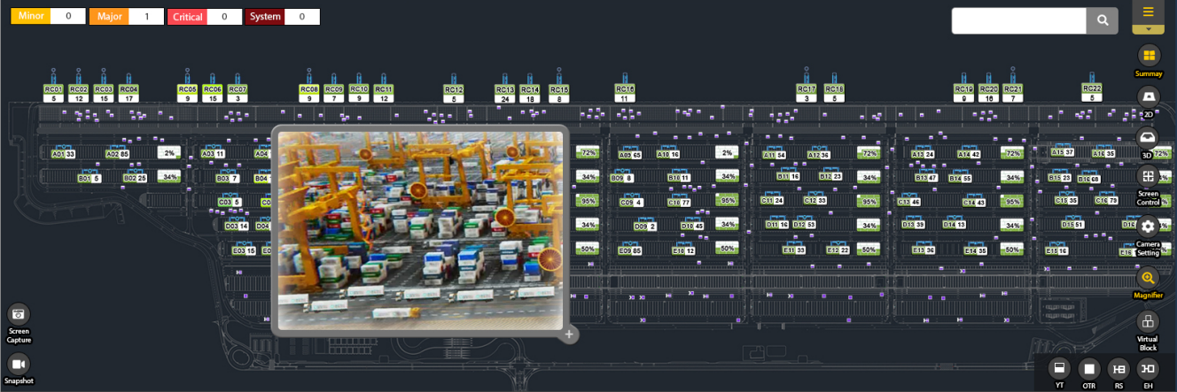

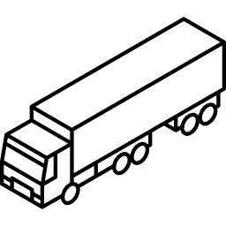
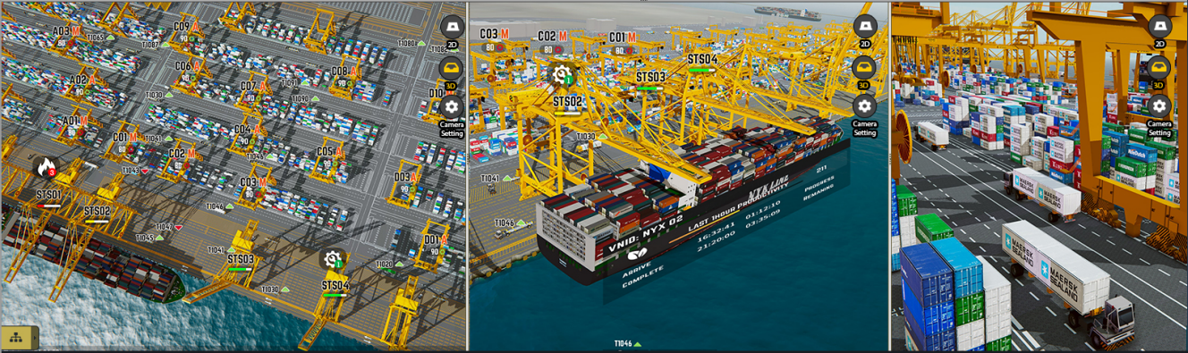
VT Monitoring Screen View > 통합검색(QC) : Current
Virtual Terminal JAT2 (V2.0)
Unified Search
2
RC06
 | 액션뷰 돋보기내에 QC 더블클릭 시 통합검색 화면
1 | 돋보기 활성화 영역 마우스 드래그로 돋보기 영역 위치한 뷰영역 확대 (ex>QC 확대) 확대영역 Object 더블클릭 시 통합검색결과영역(창) 2번 활성화
2 | 통합검색창 해당 QC의 통합검색 결과 출력
3 | Current 탭 현시점의 해당 Object의 Job Info, Container Info, Alarm Info 출력
4 | Partner Machine QC의 Partner Machine(ITV)의 Visual Effect 처리(Ex>ITV 테두리 주변색이 변하고 깜빡이는 효과)
5
6
7
8
9
10
Current
Historical
3
4
Result
Name : RC06
Location : 62B-22
Job Type : LD
Job Status : Processing
Move On/Off : Off
2
1
23MPH
T1012
9.8km/h(F/1)
1
Job Info
CNTR Num | NYKU3007 372 | Job Type | LD
OPR | NYK | ISO | 2210
Staus | Processing | Working MCH | T1012
Partner MCH | T104 | From Location | 62B-22
To Location | 64D-61-F-7 | Time Lap | 16:40:51
Loc Type | TPW | VslCd | HJCQ
VoyNo | 45656575 | PlanSeq | 111353
JobFlag Info | - | Twin TandemFlg | -
Twin Tandem Key | - | TandemJoinYT | -
ConePlan | 1 | Fore/After | F
ETA | 20 Min
Container Info
Gang | Pool1 | Name | NYKU3007 372
ISO | 4500 | Type | GE
Cargo | M | Opr | -
Class | XX | Pod | -
Fpod | - | Damage | -
Seal | - | F/M | -
Grade | -
Alarm Info
Alarm Level | Critical | Equipment ID | T1012
Time | 2018-08-20 13:37:55 | Equipment Status | Inactive
Alarm Type | W02 | Alarm Description | Tire Puncture
Net : ON QC (6/19), YT (123/200) OTR (0), JOB (19/352)
Latitude : 24.981394 Longitude : 55.054231 Server (CPU : 20%, RAM : 45%)

Slide 6
VT Monitoring Screen View > 통합검색(QC) : Historical
Virtual Terminal JAT2 (V2.0)
Unified Search
RC06
1 | Historical 탭 해당 QC의 기본정보와 과거 작업이력을 Job Process순으로 정렬
2 | Object 기본정보 해당 Object의 기본정보 출력(ex>QC)
3 | Job History QC의 과거 작업순 기준 JobList, AlarmList 출력(AlarmList는 발생시에만 노출
4
5
6
7
8
9
10
Current
Historical
1
Result
2
Name : RC06
Location : 62B-22
Job Type : LD
Job Status : Processing
Move On/Off : Off
2
23MPH
T1012
9.8km/h(F/1)
1
Job History
3
JobList
CNTR Num | NYKU3007 372 | Job Type | LD
OPR | NYK | ISO | 2210
Staus | Completed | Working MCH | T1012
Partner MCH | B08 | From Location | 14A-15-B-2
To Location | 64D-61-F-7 | Time Lap | 16:40:51
Loc Type | TPW | VslCd | HJCQ
VoyNo | 45656575 | PlanSeq | 111353
JobFlag Info | - | Twin TandemFlg | -
Twin Tandem Key | - | TandemJoinYT | -
ConePlan | 1 | Fore/After | F
ETA | 20 Min
More Info ▼
AlarmList
Alarm Level | Critical | Equipment ID | T1012
Time | 2018-08-20 13:37:55 | Equipment Status | Inactive
Alarm Type | CMTC01 | Alarm Description | ARMGC Fire Alarm
More Info ▼
Net : ON QC (6/19), YT (123/200) OTR (0), JOB (19/352)
Latitude : 24.981394 Longitude : 55.054231 Server (CPU : 20%, RAM : 45%)

Slide 7
VT Monitoring Screen View > 통합검색(QC) : Historical
Virtual Terminal JAT2 (V2.0)
Unified Search
RC06
1 | Historical 펼친 화면 Job History의 더보기 버튼 클릭 시 펼친 화면
2
3
4
5
6
7
8
9
10
Current
Historical
1
Result
Name : RC06
Location : 62B-22
Job Type : LD
Job Status : Processing
Move On/Off : Off
2
3
23MPH
T1012
9.8km/h(F/1)
1
Job History
JobList
CNTR Num | NYKU3007 372 | Job Type | LD
OPR | NYK | ISO | 2210
Staus | Completed | Working MCH | T1012
Partner MCH | B08 | From Location | 14A-15-B-2
To Location | 64D-61-F-7 | Time Lap | 16:40:51
Loc Type | TPW | VslCd | HJCQ
VoyNo | 45656575 | PlanSeq | 111353
JobFlag Info | - | Twin TandemFlg | -
Twin Tandem Key | - | TandemJoinYT | -
ConePlan | 1 | Fore/After | F
ETA | 20 Min
CNTR Num | GESU3007 372 | Job Type | DS
OPR | NYK | ISO | 2210
Staus | Completed | Working MCH | T1012
Partner MCH | C12 | From Location | 14A-15-B-2
To Location | 64D-61-F-7 | Time Lap | 17:12:02
Loc Type | TPW | VslCd | HJCQ
VoyNo | 45656575 | PlanSeq | 111353
JobFlag Info | - | Twin TandemFlg | -
Twin Tandem Key | - | TandemJoinYT | -
ConePlan | 1 | Fore/After | F
ETA | 20 Min
다음화면 연결
Net : ON QC (6/19), YT (123/200) OTR (0), JOB (19/352)
Latitude : 24.981394 Longitude : 55.054231 Server (CPU : 20%, RAM : 45%)

Slide 8
VT Monitoring Screen View > 통합검색(QC) : Historical
CNTR Num | NYKU3007 372 | Job Type | LD
OPR | NYK | ISO | 2210
Staus | Completed | Working MCH | T1012
Partner MCH | B08 | From Location | 14A-15-B-2
To Location | 64D-61-F-7 | Time Lap | 16:40:51
Loc Type | TPW | VslCd | HJCQ
VoyNo | 45656575 | PlanSeq | 111353
JobFlag Info | - | Twin TandemFlg | -
Twin Tandem Key | - | TandemJoinYT | -
ConePlan | 1 | Fore/After | F
ETA | 20 Min
4
5
6
7
8
9
10
Close ▲
AlarmList
Alarm Level | Critical | Equipment ID | RC06
Time | 2018-08-20 13:37:55 | Equipment Status | Inactive
Alarm Type | W02 | Alarm Description | STS Fire Alarm
Alarm Level | Critical | Equipment ID | RC06
Time | 2018-08-20 13:37:55 | Equipment Status | Inactive
Alarm Type | W04 | Alarm Description | Equipment Disconnect
Alarm Level | Critical | Equipment ID | RC06
Time | 2018-08-20 13:37:55 | Equipment Status | Inactive
Alarm Type | W03 | Alarm Description | Cone attached Check
Alarm Level | Critical | Equipment ID | RC06
Time | 2018-08-20 13:37:55 | Equipment Status | Inactive
Alarm Type | C07 | Alarm Description | VTIS System Disconnectd
Close ▲
이전화면 연결

Slide 9

VT Monitoring Screen View > 통합검색(TC) : Current
Virtual Terminal JAT2 (V2.0)
Unified Search
2
B02
 | 액션뷰 돋보기내에 TC 더블클릭 시 통합검색 화면
1 | 돋보기 활성화 영역 마우스 드래그로 돋보기 영역 위치한 뷰영역 확대 (ex>TC 확대) 확대영역 Object 더블클릭 시 통합검색결과영역(창) 2번 활성화
2 | 통합검색창 해당 TC의 통합검색 결과 출력
3 | Current 탭 현시점의 해당 Object의 Job Info, Container Info, Alarm Info 출력
4 | Partner Machine TC의 Partner Machine(ITV or OTR)의 Visual Effect 처리(Ex>ITV 테두리 주변색이 변하고 깜빡이는 효과)
5
6
7
8
9
10
Current
Historical
3
4
Result
Name : B02
Location : 62B-22
Job Type : LD
Job Status : Processing
Move On/Off : ON
2
3
1
23MPH
T1012
9.8km/h(F/1)
1
Job Info
CNTR Num | NYKU3007 372 | Job Type | LD
OPR | NYK | ISO | 2210
Staus | Processing | Working MCH | B02
Partner MCH | T104 | From Location | 62B-22
To Location | 64D-61-F-7 | Time Lap | 16:40:51
Loc Type | TPW | VslCd | HJCQ
VoyNo | 45656575 | PlanSeq | 111353
JobFlag Info | - | Twin TandemFlg | -
Twin Tandem Key | - | TandemJoinYT | -
ConePlan | 1 | Fore/After | F
ETA | 20 Min
Container Info
Gang | Pool1 | Name | NYKU3007 372
ISO | 4500 | Type | GE
Cargo | M | Opr | -
Class | XX | Pod | -
Fpod | - | Damage | -
Seal | - | F/M | -
Grade | -
Alarm Info
Alarm Level | Critical | Equipment ID | B02
Time | 2018-08-20 13:37:55 | Equipment Status | active
Alarm Type | W02 | Alarm Description | ARMGC Crane Pick Up Over Weight
Net : ON QC (6/19), YT (123/200) OTR (0), JOB (19/352)
Latitude : 24.981394 Longitude : 55.054231 Server (CPU : 20%, RAM : 45%)

Slide 10
VT Monitoring Screen View > 통합검색(TC) : Historical
Virtual Terminal JAT2 (V2.0)
Unified Search
B02
1 | Historical 탭 해당 TC의 기본정보와 과거 작업이력을 Job Process순으로 정렬
2 | Object 기본정보 해당 Object의 기본정보 출력(ex>TC)
3 | Job History TC의 과거 작업순 기준 JobList, AlarmList 출력(AlarmList는 발생시에만 노출
4
5
6
7
8
9
10
Current
Historical
1
Result
2
Name : B02
Location : 62B-22
Job Type : LD
Job Status : Processing
Move On/Off : Off
2
3
23MPH
T1012
9.8km/h(F/1)
1
Job History
3
3
JobList
CNTR Num | NYKU3007 372 | Job Type | LD
OPR | NYK | ISO | 2210
Staus | Completed | Working MCH | B02
Partner MCH | B08 | From Location | 14A-15-B-2
To Location | 64D-61-F-7 | Time Lap | 16:40:51
Loc Type | TPW | VslCd | HJCQ
VoyNo | 45656575 | PlanSeq | 111353
JobFlag Info | - | Twin TandemFlg | -
Twin Tandem Key | - | TandemJoinYT | -
ConePlan | 1 | Fore/After | F
ETA | 20 Min
4
More Info ▼
AlarmList
Alarm Level | Critical | Equipment ID | B02
Time | 2018-08-20 13:37:55 | Equipment Status | Inactive
Alarm Type | CMTC01 | Alarm Description | ARMGC Fire Alarm
5
More Info ▼
Net : ON QC (6/19), YT (123/200) OTR (0), JOB (19/352)
Latitude : 24.981394 Longitude : 55.054231 Server (CPU : 20%, RAM : 45%)

Slide 11
VT Monitoring Screen View > 통합검색(TC) : Historical
Virtual Terminal JAT2 (V2.0)
Unified Search
B02
1 | Historical 펼친 화면 Job History의 더보기 버튼 클릭 시 펼친 화면
2
3
4
5
6
7
8
9
10
Current
Historical
1
Result
Name : B02
Location : 62B-22
Job Type : LD
Job Status : Processing
Move On/Off : Off
2
3
23MPH
T1012
9.8km/h(F/1)
1
Job History
JobList
CNTR Num | NYKU3007 372 | Job Type | LD
OPR | NYK | ISO | 2210
Staus | Completed | Working MCH | B02
Partner MCH | T018 | From Location | 14A-15-B-2
To Location | 64D-61-F-7 | Time Lap | 16:40:51
Loc Type | TPW | VslCd | HJCQ
VoyNo | 45656575 | PlanSeq | 111353
JobFlag Info | - | Twin TandemFlg | -
Twin Tandem Key | - | TandemJoinYT | -
ConePlan | 1 | Fore/After | F
ETA | 20 Min
CNTR Num | GESU3007 372 | Job Type | DS
OPR | NYK | ISO | 2210
Staus | Completed | Working MCH | B02
Partner MCH | T193 | From Location | 14A-15-B-2
To Location | 64D-61-F-7 | Time Lap | 17:12:02
Loc Type | TPW | VslCd | HJCQ
VoyNo | 45656575 | PlanSeq | 111353
JobFlag Info | - | Twin TandemFlg | -
Twin Tandem Key | - | TandemJoinYT | -
ConePlan | 1 | Fore/After | F
ETA | 20 Min
다음화면 연결
Net : ON QC (6/19), YT (123/200) OTR (0), JOB (19/352)
Latitude : 24.981394 Longitude : 55.054231 Server (CPU : 20%, RAM : 45%)

Slide 12
VT Monitoring Screen View > 통합검색(TC) : Historical
CNTR Num | NYKU3007 372 | Job Type | LD
OPR | NYK | ISO | 2210
Staus | Completed | Working MCH | B02
Partner MCH | B08 | From Location | 14A-15-B-2
To Location | 64D-61-F-7 | Time Lap | 16:40:51
Loc Type | TPW | VslCd | HJCQ
VoyNo | 45656575 | PlanSeq | 111353
JobFlag Info | - | Twin TandemFlg | -
Twin Tandem Key | - | TandemJoinYT | -
ConePlan | 1 | Fore/After | F
ETA | 20 Min
4
5
6
7
8
9
10
Close ▲
AlarmList
Alarm Level | Major | Equipment ID | B02
Time | 2018-08-20 13:37:55 | Equipment Status | Inactive
Alarm Type | W02 | Alarm Description | Tire Puncture
Alarm Level | Critical | Equipment ID | B02
Time | 2018-08-20 13:37:55 | Equipment Status | Inactive
Alarm Type | W04 | Alarm Description | Equipment Disconnect
Alarm Level | Critical | Equipment ID | B02
Time | 2018-08-20 13:37:55 | Equipment Status | Inactive
Alarm Type | W03 | Alarm Description | Cone attached Check
Alarm Level | Critical | Equipment ID | B02
Time | 2018-08-20 13:37:55 | Equipment Status | Inactive
Alarm Type | C07 | Alarm Description | VTIS System Disconnectd
Close ▲
이전화면 연결

