Slide 1
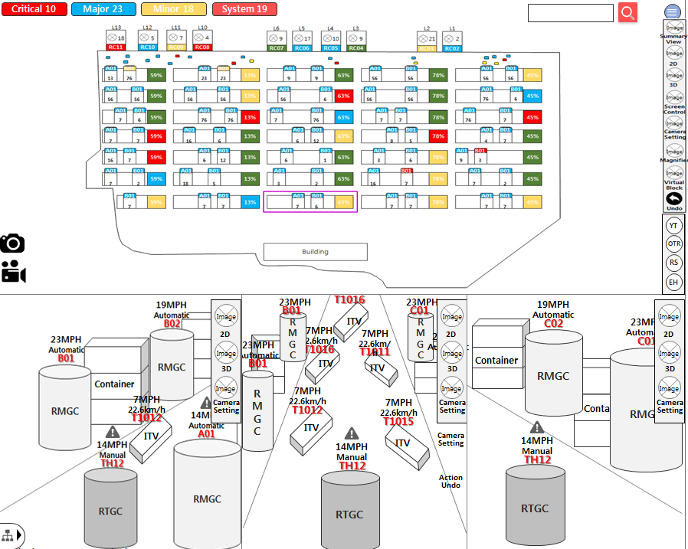
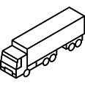
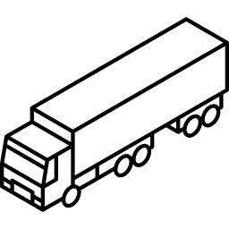
VT Monitoring Screen View > 통합검색 : Current
Virtual Terminal JAT2 (V2.0)
3
Unified Search
T1012
 | 액션뷰 돋보기내에 IIV 더블클릭 시 통합검색 화면
1 | 돋보기(Magnifier) 버튼 버튼 클릭 시 2번 돋보기 영역 활성화
2 | 돋보기 활성화 영역 마우스 드래그로 돋보기 영역 위치한 뷰영역 확대 (ex>ITV 확대) 확대영역 Object 더블클릭 시 통합검색결과영역(창) 3번 활성화
3 | 통합검색창 해당 Object의 통합검색 결과 출력
4 | Current 탭 현시점의 해당 Object의 Job Info, Container Info, Alarm Info 출력
5
6
7
8
9
10
Current
Historical
4
Result
Name : T1012
Job Type : LD
Job Status : Processing
Operation MD : Automatic
Move On/Off : On
1
Job Info
CNTR Num | NYKU3007 372 | Job Type | LD
OPR | NYK | ISO | 2210
Staus | Processing | Working MCH | T1012
Partner MCH | B08 | From Location | 14A-15-B-2
To Location | 64D-61-F-7 | Time Lap | 16:40:51
Loc Type | TPW | VslCd | HJCQ
VoyNo | 45656575 | PlanSeq | 111353
JobFlag Info | - | Twin TandemFlg | -
Twin Tandem Key | - | TandemJoinYT | -
ConePlan | 1 | Fore/After | F
ETA | 20 Min
Container Info
Gang | Pool1 | Name | NYKU3007 372
ISO | 4500 | Type | GE
Cargo | M | Opr | -
Class | XX | Pod | -
Fpod | - | Damage | -
Seal | - | F/M | -
Grade | -
2
23MPH
T1012
9.8km/h(F/1)
Alarm Info
Alarm Level | Critical | Equipment ID | T1012
Time | 2018-08-20 13:37:55 | Equipment Status | Inactive
Alarm Type | W02 | Alarm Description | Tire Puncture
Net : ON QC (6/19), YT (123/200) OTR (0), JOB (19/352)
Latitude : 24.981394 Longitude : 55.054231 Server (CPU : 20%, RAM : 45%)

Slide 2
VT Monitoring Screen View > 통합검색 : Historical
Virtual Terminal JAT2 (V2.0)
Unified Search
T1012
1 | Historical 탭 해당 Object의 기본정보와 과거 작업이력을 Job Process순으로 정렬
2 | Object 기본정보 해당 Object의 기본정보 출력(ex>ITV)
3 | Job History ITV의 과거 작업순 기준 CHE의 JobList, AlarmList 출력(AlarmList는 발생시에만 노출)
4 | 더보기 버튼 클릭 시 하단 JobList 내역 출력(4p)
5 | 더보기 버튼 클릭 시 하단 alarm 내역 출력(4p)
6
7
8
9
10
Current
Historical
1
Result
2
Name : T1012
Job Type : LD
Job Status : Processing
Operation MD : Automatic
Move On/Off : On
Job History
3
JobList
CNTR Num | NYKU3007 372 | Job Type | LD
OPR | NYK | ISO | 2210
Staus | Processing | Working MCH | T1012
Partner MCH | B08 | From Location | 14A-15-B-2
To Location | 64D-61-F-7 | Time Lap | 16:40:51
Loc Type | TPW | VslCd | HJCQ
VoyNo | 45656575 | PlanSeq | 111353
JobFlag Info | - | Twin TandemFlg | -
Twin Tandem Key | - | TandemJoinYT | -
ConePlan | 1 | Fore/After | F
ETA | 20 Min
4
More Info ▼
23MPH
AlarmList
T1012
9.8km/h(F/1)
Alarm Level | Critical | Equipment ID | T1012
Time | 2018-08-20 13:37:55 | Equipment Status | Inactive
Alarm Type | W02 | Alarm Description | Tire Puncture
5
More Info ▼
다음화면 연결
Net : ON QC (6/19), YT (123/200) OTR (0), JOB (19/352)
Latitude : 24.981394 Longitude : 55.054231 Server (CPU : 20%, RAM : 45%)

Slide 3
VT Monitoring Screen View > 통합검색 : Historical
Virtual Terminal JAT2 (V2.0)
Unified Search
T1012
1 | Historical 탭 해당 Object의 기본정보와 과거 작업이력을 Job Process순으로 정렬
2 | Object 기본정보 해당 Object의 기본정보 출력(ex>ITV)
3 | Job History ITV의 과거 작업순 기준 JobList, AlarmList 출력(AlarmList는 발생시에만 노출)
4
5
6
7
8
9
10
Current
Historical
1
Result
2
Name : T1012
Job Type : LD
Job Status : Processing
Operation MD : Automatic
Move On/Off : On
Job History
3
JobList
CNTR Num | NYKU3007 372 | Job Type | LD
OPR | NYK | ISO | 2210
Staus | Completed | Working MCH | T1012
Partner MCH | B08 | From Location | 14A-15-B-2
To Location | 64D-61-F-7 | Time Lap | 16:40:51
Loc Type | TPW | VslCd | HJCQ
VoyNo | 45656575 | PlanSeq | 111353
JobFlag Info | - | Twin TandemFlg | -
Twin Tandem Key | - | TandemJoinYT | -
ConePlan | 1 | Fore/After | F
ETA | 20 Min
CNTR Num | GESU3007 372 | Job Type | DS
OPR | NYK | ISO | 2210
Staus | Completed | Working MCH | T1012
Partner MCH | C12 | From Location | 14A-15-B-2
To Location | 64D-61-F-7 | Time Lap | 17:12:02
Loc Type | TPW | VslCd | HJCQ
VoyNo | 45656575 | PlanSeq | 111353
JobFlag Info | - | Twin TandemFlg | -
Twin Tandem Key | - | TandemJoinYT | -
ConePlan | 1 | Fore/After | F
ETA | 20 Min
23MPH
T1012
9.8km/h(F/1)
다음화면 연결
Net : ON QC (6/19), YT (123/200) OTR (0), JOB (19/352)
Latitude : 24.981394 Longitude : 55.054231 Server (CPU : 20%, RAM : 45%)

Slide 4
VT Monitoring Screen View > 통합검색 : Historical
CNTR Num | NYKU3007 372 | Job Type | LD
OPR | NYK | ISO | 2210
Staus | Completed | Working MCH | T1012
Partner MCH | B08 | From Location | 14A-15-B-2
To Location | 64D-61-F-7 | Time Lap | 16:40:51
Loc Type | TPW | VslCd | HJCQ
VoyNo | 45656575 | PlanSeq | 111353
JobFlag Info | - | Twin TandemFlg | -
Twin Tandem Key | - | TandemJoinYT | -
ConePlan | 1 | Fore/After | F
ETA | 20 Min
4 | 닫기 버튼 클릭 시 펼쳐진 영역 닫고 원복(2p)
5
6
7
8
9
10
Close ▲
4
AlarmList
Alarm Level | Critical | Equipment ID | T1012
Time | 2018-08-20 13:37:55 | Equipment Status | Inactive
Alarm Type | W02 | Alarm Description | Tire Puncture
Alarm Level | Major | Equipment ID | T1012
Time | 2018-08-20 13:37:55 | Equipment Status | Inactive
Alarm Type | W04 | Alarm Description | Equipment Disconnect
Alarm Level | Critical | Equipment ID | T1012
Time | 2018-08-20 13:37:55 | Equipment Status | Inactive
Alarm Type | W03 | Alarm Description | Cone attached Check
Alarm Level | Critical | Equipment ID | T1012
Time | 2018-08-20 13:37:55 | Equipment Status | Inactive
Alarm Type | C07 | Alarm Description | VTIS System Disconnectd
4
Close ▲
이전화면 연결

